Slide 1
Chapter 5
KNOWLEDGE REPRESENTATION
Cios / Pedrycz / Swiniarski / Kurgan

Slide 2
Outline
Introduction
Main categories of data representation schemes
Granularity of data and its underlying taxonomy
Design aspects

Slide 3
Knowledge Representation
Available sources of knowledge are highly diversified and as such need to be represented in different ways
Representation schemes are essential for processing of data and revealing relationships
Granularity of information is an ultimate vehicle of abstraction which becomes essential in description of relationships formed in data mining

Slide 4
Types of Data:
Continuous Quantitative Data
Concern continuous variables, such as pressure, temperature, and height
They occur very often in relationship to some physical phenomena that generated such variables
Linear order is commonly encountered

Slide 5

Types of Data:
Continuous Quantitative Data
Linear order of real numbers

Slide 6
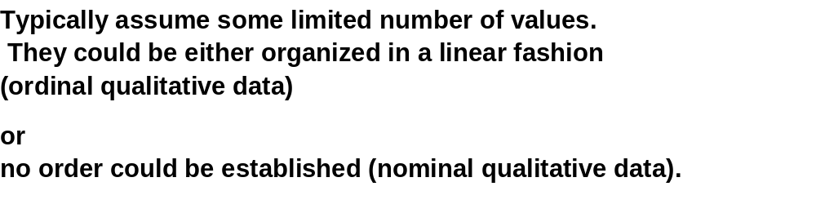
Types of Data:
Qualitative Data

Slide 7

Ordinal Qualitative Data

Slide 8
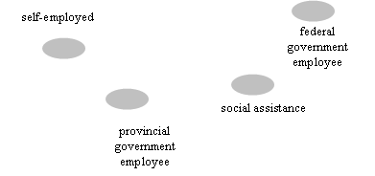
Nominal Qualitative Data

Slide 9
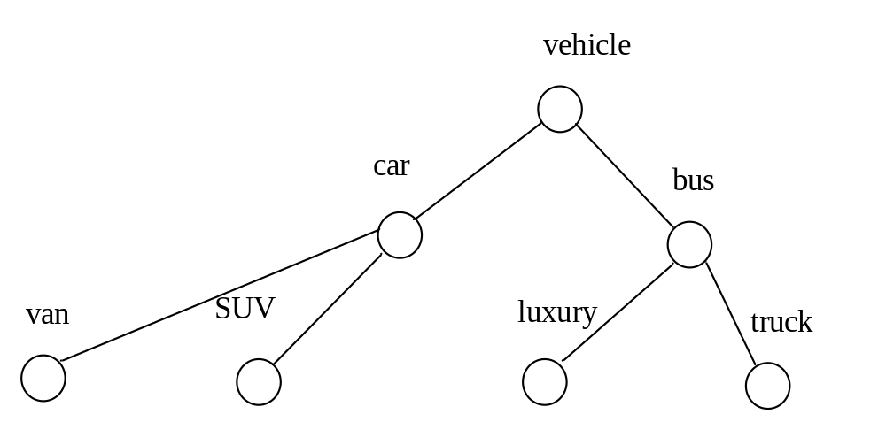
Structured Data
Forms some structure and leads to a hierarchy of nested concepts
More specialized concepts occur at lower level of hierarchy
Commonly represented in some tree structures

Slide 10
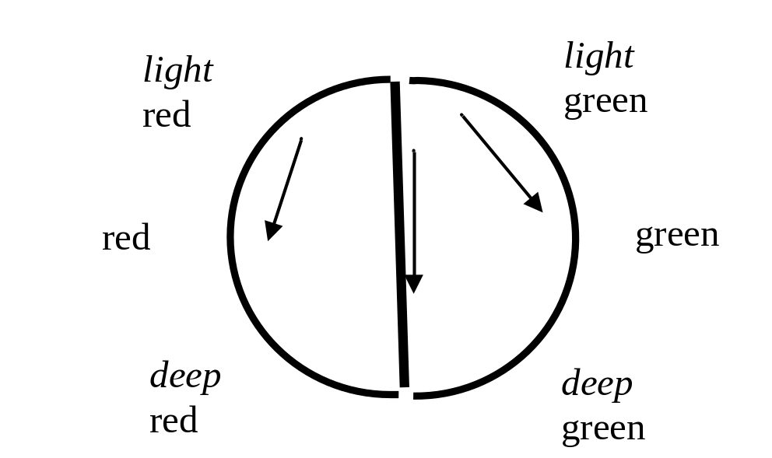
Structured Data
Some may form a lattice structure for concepts being
perceived by human observers:
Maximal and minimal element
Not all elements organized in a linear fashion

Slide 11
Categories of Models of
Knowledge Representation
Rules
Graphs and directed graphs
Trees
Networks

Slide 12
Rules and Their Taxonomy
Generic format
IF condition THEN conclusion (action)
Conditions and conclusions are descriptors of domain
knowledge about the problem
In general, we encounter a finite collection of rules
IF condition is A_{i} THEN conclusion is B_{i}
Commonly, the rules are multivariable, namely, they consist
a number of variables (conditions)
- IF condition₁ and condition₂ and …. and condition_{n} THEN conclusion

Slide 13
Gradual Rules
“The higher the values of condition, the higher the values of conclusion”
or
“the lower the values of condition, the higher the values of conclusion”
Capture a notion of graduality between the concepts
occurring in the conditions and conclusions
IF τ(A_{i}) THEN μ(B_{i})

Slide 14
Quantified Rules
Quantification of confidence of rules
the likelihood that high fluctuations in real estate prices
lead to a significant migration of population within the province
is quite moderate.
Confidence of rule

Slide 15
Analogical Rules
Focus on analogy (similarity, closeness, resemblance…)
between conditions and conclusions
IF similarity (A_{i}, A_{j}) THEN similarity (B_{i}, B_{j})
expressing analogy

Slide 16
Rules with Regression
Local Models
More advanced and functionally augmented conclusion part
of the rule.
It involves some regression model
IF condition is A_{i} THEN y = f_{i}(x, a_{i})
local regression model
One could consider other generalizations such as neural networks
forming the condition part of the rule

Slide 17
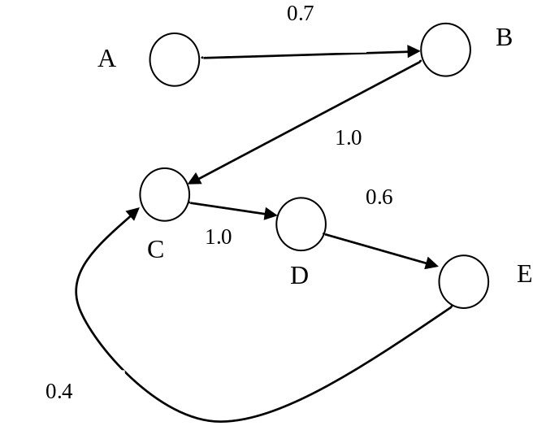
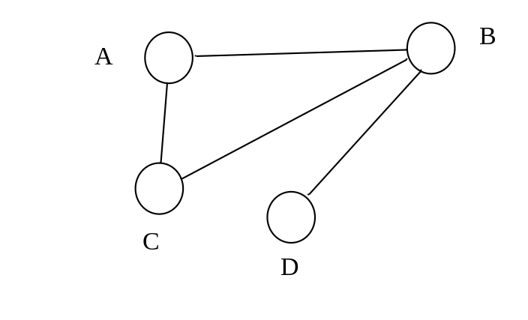
Graphs and Directed Graphs
Concepts, and links between them that express relationships between concepts.
Two main categories of graphs:
(a) undirected graphs
(b) directed graphs

Slide 18
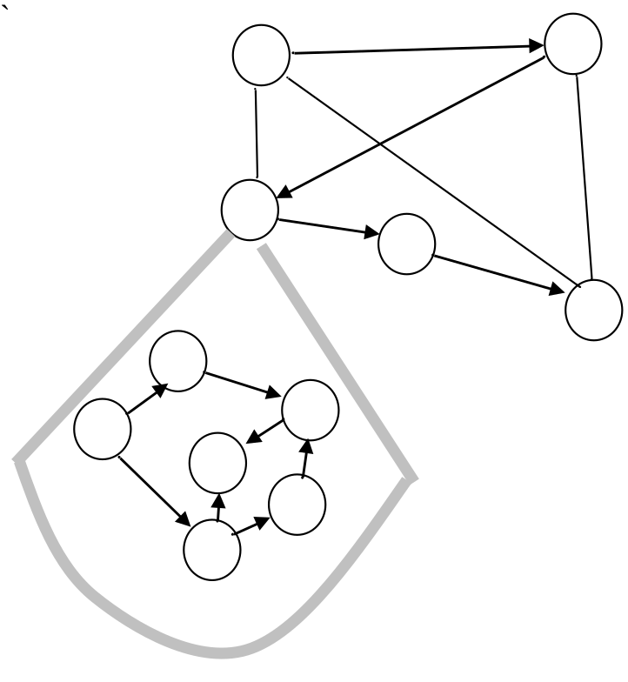
Hierarchy of Graphs
Refinement of relationships starting from the most general
relationships (with general nodes) and expansion of the nodes

Slide 19
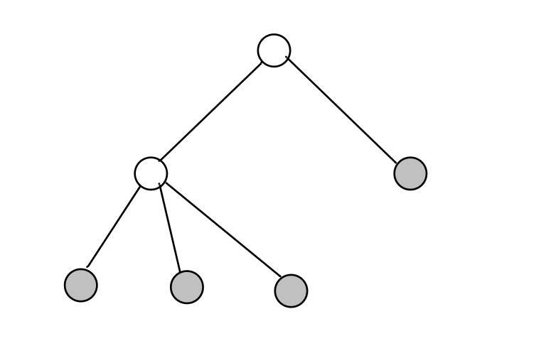
Trees
An important category of graphs in which
Single root
No loops
Some terminal nodes
root
Terminal nodes

Slide 20
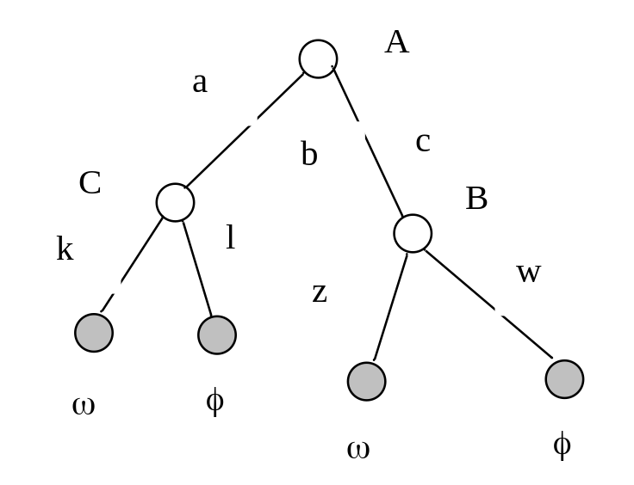
Decision Trees
Decision tree → rules
IF A is c and B is w THEN φ
IF A is c and B is z THEN ω
IF A is a and C is k THEN ω
IF A is a and C is l THEN φ

Slide 21
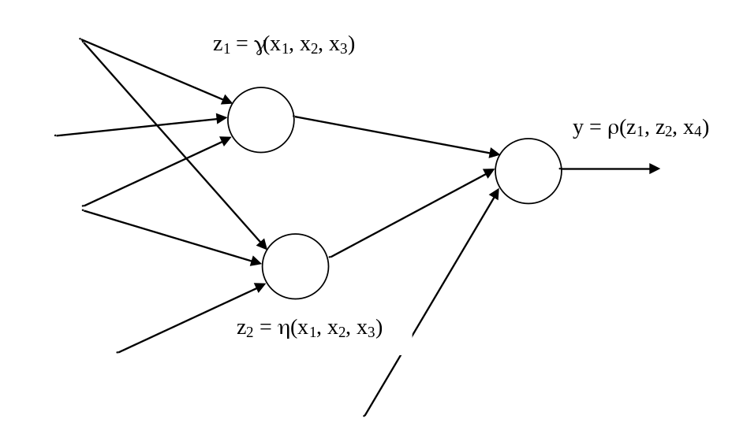
Networks
Generalized graphs with nodes endowed with processing capabilities
For instance,
Each node computes some logic formula using input variables and
logic operators (conjunction, disjunction, complement)
(b) Node could be a local neural network

Slide 22
Information Granules and Information Granularity
Information granules support human-centric computing.
By human-centricity we mean all faculties of the computing systems
that facilitate interaction with human users, either by improving and enhancing the quality of communication of findings or by accepting inputs from users realized in a more flexible and friendly manner, say, in some linguistic form.
Information granules tend to permeate human endeavors. No matter what a given task is we usually cast it into a certain conceptual framework of generic entities we perceive to be of relevance. This is the framework in which we:
formulate generic concepts adhering to some level of abstraction,
carry out processing
communicate the results to the external environment.

Slide 23
Information Granules:
Examples
Image processing
Humans do not focus on individual pixels and process them afterwards,
but group them together into semantically meaningful constructs:
-regions that consist of groups of pixels drawn together
owing to their proximity in the location on image, similar texture, color,
level of brightness, etc.
Signal processing
We describe signals in a semi-qualitative manner by identifying specific regions
of the signals both in time or frequency domain. E.g., specialists easily interpret
ECG signals by identifying some segments and their combinations.

Slide 24
Granular Computing as an Emerging Paradigm
Identifies essential commonalities between diversified problems and technologies, cast into a unified framework we referred to as a granular world.
With granular processing we get a better grasp as to the role of interaction between various formalisms and visualize a way in which they communicate.
It brings together the existing formalisms of set theory, fuzzy sets, rough sets, etc., by clearly visualizing that in spite of their visibly distinct underpinnings Granular Computing establishes a viable environment of building synergy between the individual approaches.

Slide 25
Granular Computing:
Key Formal Frameworks
Set theory (interval analysis)
Fuzzy Sets
Rough Sets
Shadowed Sets

Slide 26


Sets
Notion of Membership
belongs to excluded from

Slide 27


Characteristic Functions
Concept of dichotomy

Slide 28
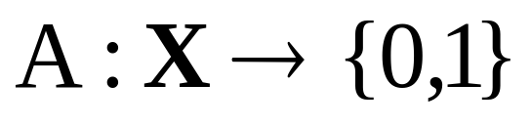
Description of Sets
Membership
  enumerate elements belonging to the set
Characteristic function
1
A(x)=0
0
A(x)=1

Slide 29
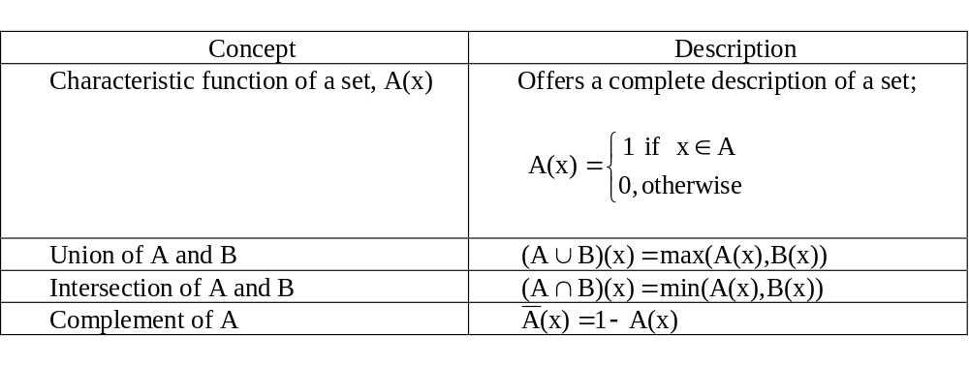
Operations on Sets

Slide 30
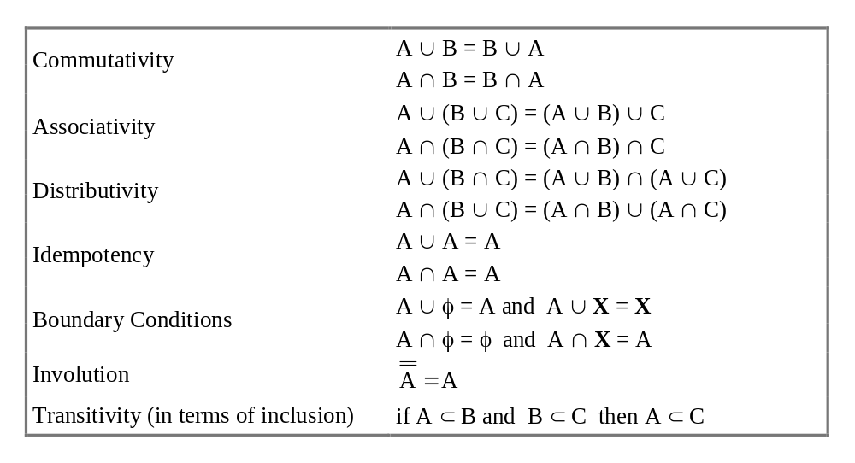
Operations on Sets

Slide 31
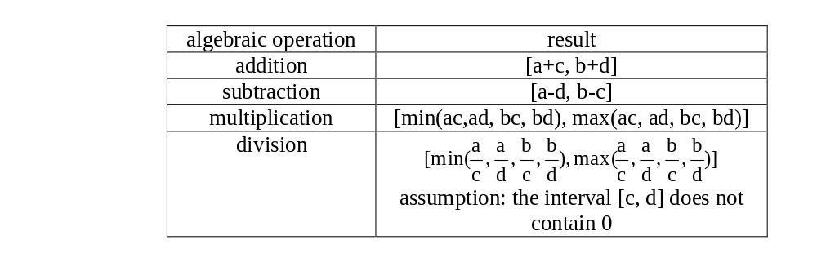
Basic Arithmetic Operations

Slide 32
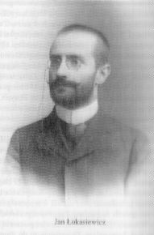
Challenge:
Three-valued Logic
Lukasiewicz (~1920)
true (0)
false (1)
don’t know (1/2)
Three valued logic

Slide 33
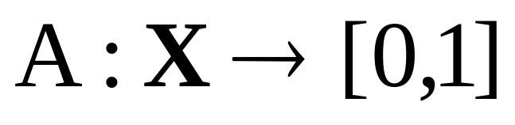
Fuzzy set - Definition
Fuzzy set A is described by its membership function A(x)
A(x) =1: complete membership
A(x) =0: complete exclusion

Slide 34
Fuzzy Sets:
Membership Functions
Partial membership of element to the set – membership degree A(x)
The higher the value of A(x), the more typical the element “x” (as a representative of A)

Slide 35
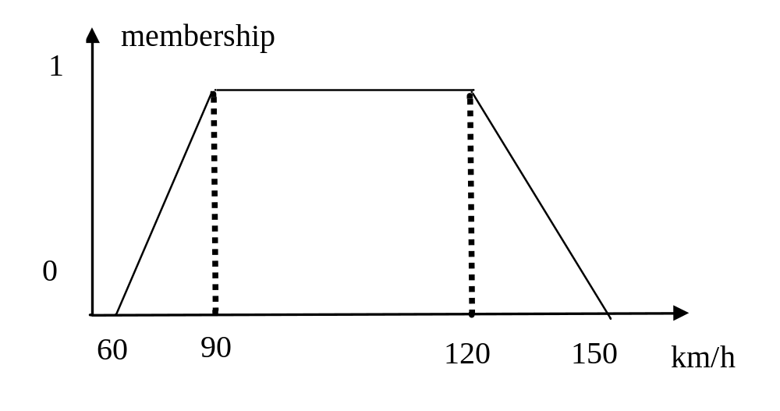
Membership Functions:
Examples

Slide 36
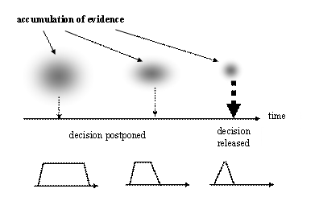
Principle of the Least Commitment

Slide 37
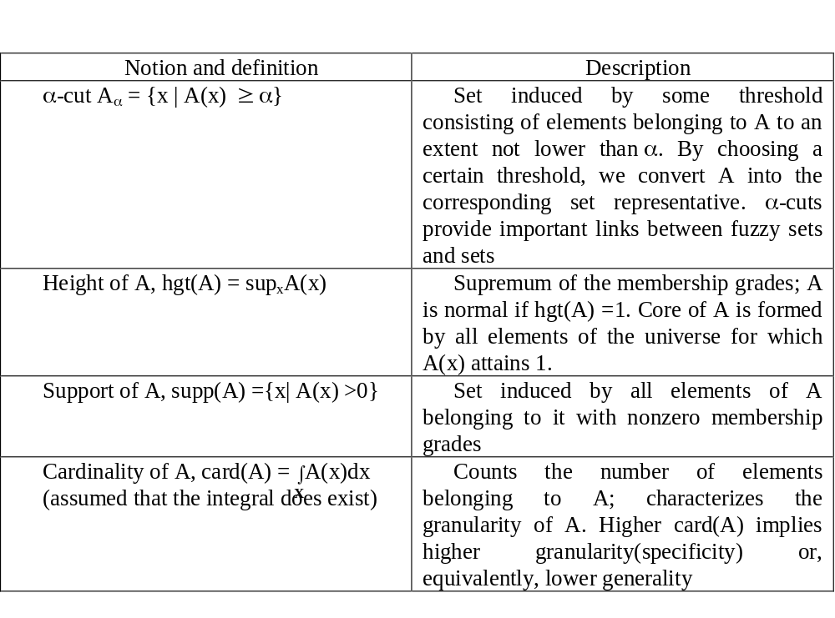
Characteristics of Fuzzy Sets

Slide 38

Operations on Fuzzy Sets: t-norms and t-conorms
t-norm
t: [0,1]² → [0,1]
such that it satisfies the collection of conditions
(a) x t y = y t x commutativity
x t (y t z) = (x t y) t z
if x < y and w < z then x t w y t z
(d) 0 t x =0, 1 t x =x boundary conditions

Slide 39
Operations on Fuzzy Sets: t-conorms
t-conorm (s-norm)
s: [0,1]² → [0,1]
such that it satisfies the collection of conditions
(a) x s y = y s x commutativity
x s (y s z) = (x s y) s z
if x < y and w < z then x s w y s z
(d) 0 s x =x, 1 s x =1 boundary conditions

Slide 40
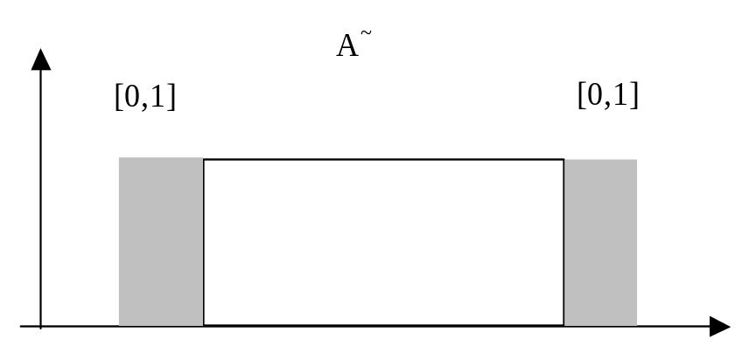
Shadowed Sets
Granular constructs in which we allow for regions of space of complete
ignorance
A~ : X → { 0, 1, [0,1]}
Exclusion Full membership Ignorance

Slide 41
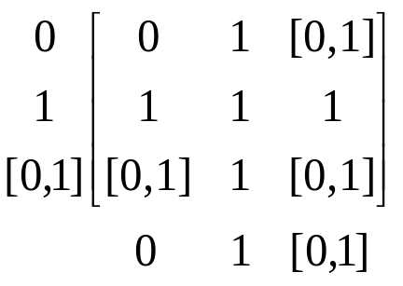
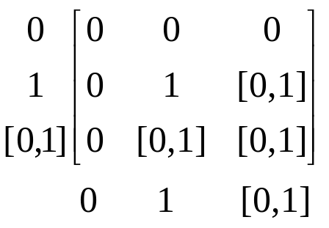
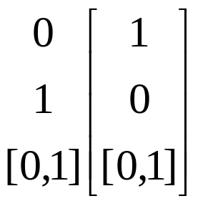
Shadowed Sets:
Logic Operations
Union Intersection
complement

Slide 42
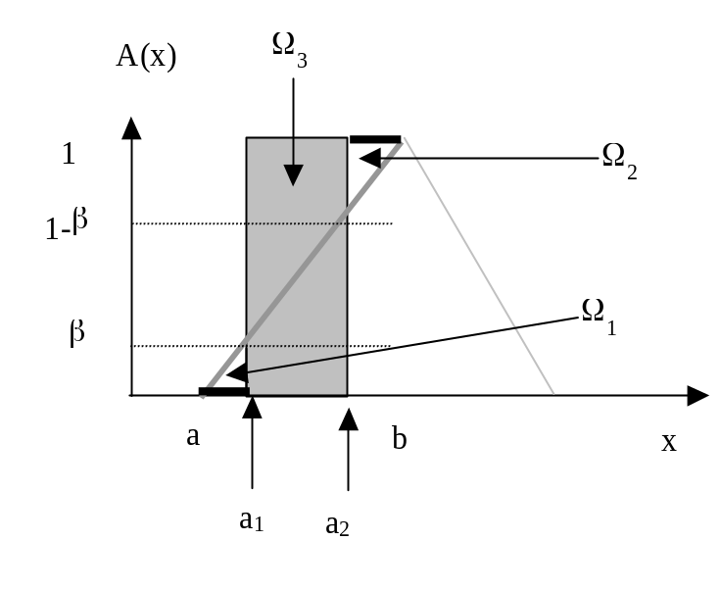
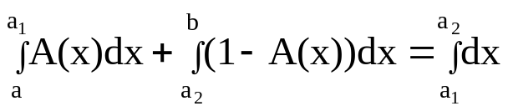
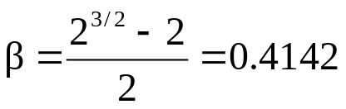
Shadowed Sets:
Estimation Method
Shadowed sets are generated (induced) on a basis of fuzzy sets:
Re-allocation of membership grades
(a) low membership grades reduced to zero
(b) high membership grades elevated to 1
(c) membership grades resulting from the reduction and elevation
are used in the formation of shadows
Ω₁ + Ω₂ = Ω₃
Linear membership function:

Slide 43
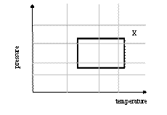
Rough Sets
Defining concept X with the use of a finite vocabulary of
information granules:
Lower bound (approximation)
Upper bound (approximation)

Slide 44
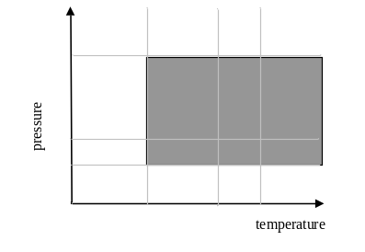
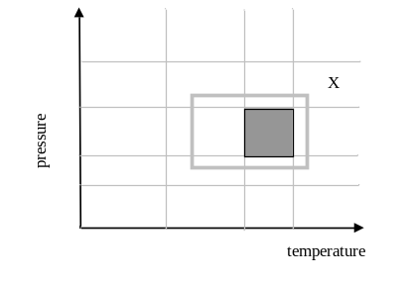
Rough Sets :
Upper and Lower Approximations
A_{i}
upper approximation
lower approximation

Slide 45
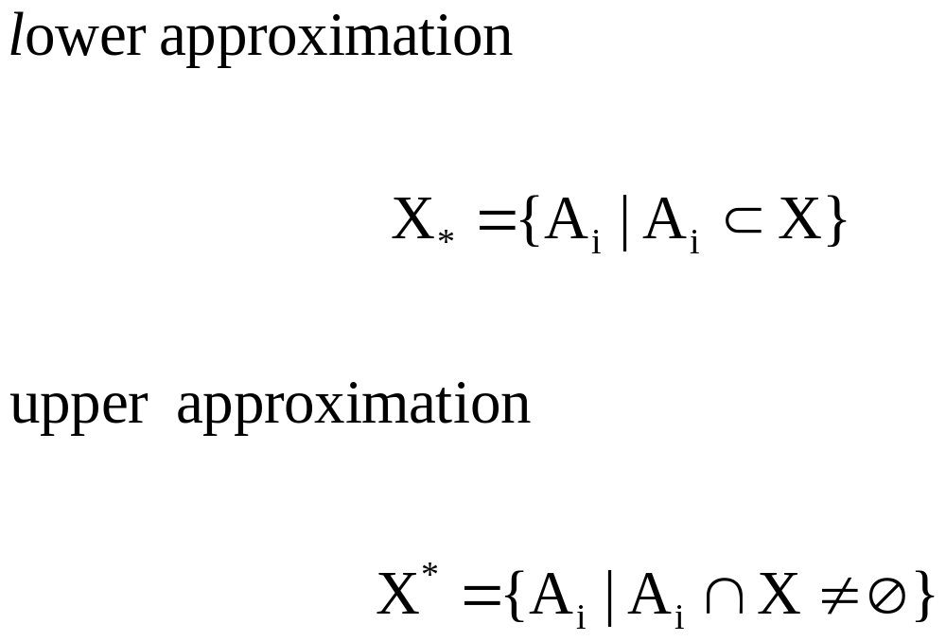
Rough Sets :
Upper and Lower Approximations

Slide 46
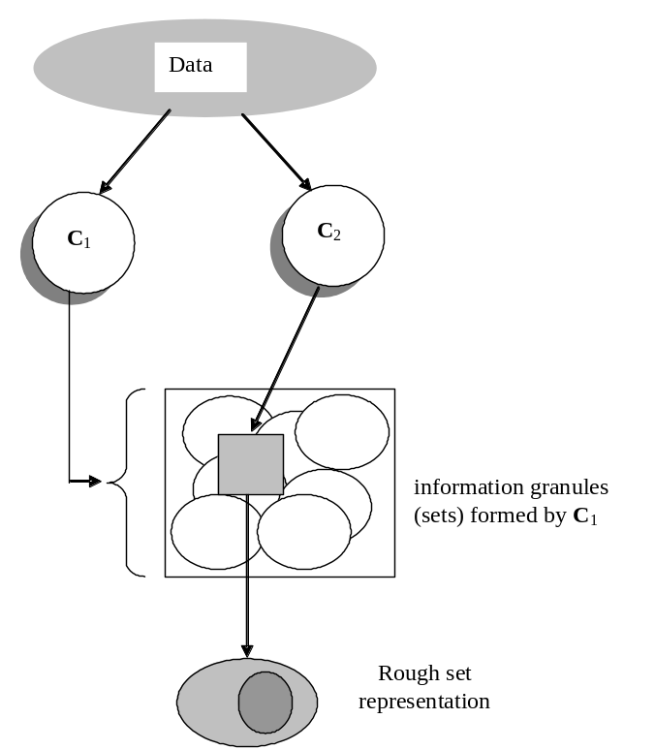
Rough Sets:
The Principle of Data Description
Given some information granules
they are used to characterize other granular view at data

Slide 47
Characterization of
Knowledge Representation Schemes
Expressive power of the scheme
Computational complexity and associated tradeoffs :
Flexibility of knowledge representation – scalability –
familiarity of the designer and users with the specific scheme of
knowledge representation
Effectiveness of forming models on a basis of the existing
domain knowledge and experimental data
Character of information granulation and the level of specificity of
information granules

Slide 48

Information Granularity
Information granules are defined at different levels of specificity
(abstraction) which is reflective of their “size”
We define measures that characterize the size of information granules
Information granules | Granularity
Fuzzy sets | In the case of a finite space X, the integral is replaced by a sum of the membership grades
Rough sets | Cardinality of the lower and upper bound, card (A₊), card (A₋); the difference between these two describes roughness of A

Slide 49
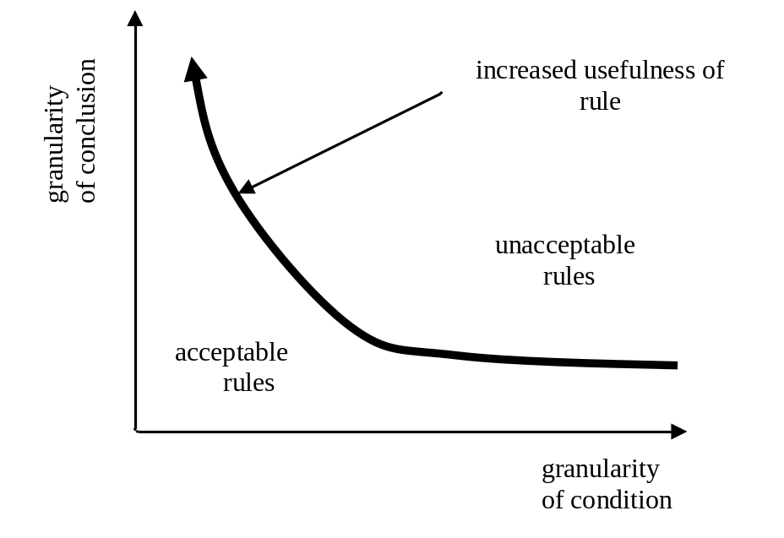
Information Granularity in Rule-based Systems

Slide 50
References
Bargiela A and Pedrycz W. 2003. Granular Computing: An Introduction,
Kluwer Academic Publishers
Giarratano J and Riley G. 1994. Expert Systems: Principles and Programming,
2nd Ed., PWS Publishing
Moore R. 1966. Interval Analysis, Prentice Hall
Pal SK and Skowron A (eds.) 1999. Rough Fuzzy Hybridization.
A New trend in Decision-Making, Springer Verlag
Pawlak Z. 1991. Rough Sets. Theoretical Aspects of Reasoning About Data,
Kluwer Academic Publishers
Pedrycz W and Gomide F. 1998. An Introduction to Fuzzy Sets; Analysis and Design.
MIT Press, 1998.
Pedrycz W (ed.). 2001. Granular Computing: An Emerging Paradigm, Physica Verlag
Zadeh LA. 1965. Fuzzy sets, Information & Control, 8, 1965, 338-353.

